Slide 1
Energy Infrastructure Risk models through Hawkes hazard models and Bayesian Vulnerability Networks
In this work, we identify energy infrastructure to be critical as its failure has a damaging impact on health, safety , security and well being of society.
We identify hazards as random events that has a causal relationship with failure of energy infrastructure.
E.g.-
Severe Weather Events:
Hurricanes/Typhoons/Cyclones - lightning
Tornadoes
Snowstorms/Ice Storms
Earthquakes
Floods
Wildfires
Volcanic Eruptions
Geomagnetic Storms
Tsunamis
Droughts
Landslides
Cyberattacks
Physical Attacks -terrorism
Technical Failures
Human Errors
Fuel Supply Disruptions
Regulatory and Policy Changes
Infrastructure Aging
Supply Chain Disruptions
Environmental Regulations
Social and Political Unrest
Economic down-turns and financial crisis
We observe these hazards has self-excitation – earthquakes increase the probability of happening more earthquakes (aftershocks).
Some of them has mutual excitation – Rainstorms increases probability of floods occurring, Earthquakes increases probability of landslides occurring.
Vulnerability represent how each hazard influences failure through exciting further hazards.
Hazard 1
Vulnerability
Failure
Excitation
Vulnerability
Hazard 2

Slide 2
Example graphical structure representing influence through cascading hazards towards failure.
Severe weather – Rainstorms
Severe weather – Snowstorms
Severe weather – Tornados
Earthquakes
Cloud cover
Human factors – terrorism, riots, political unrest
Wildfires
Floods
landslides
Reduced Solar
Fuel and supply disruption
Aging infrastructure
Maintenance Disturbances
Generation infrastructure damage
Generation disruption
Transmission/ Distribution line disruption
Failure - Supply disruption at households

Slide 3
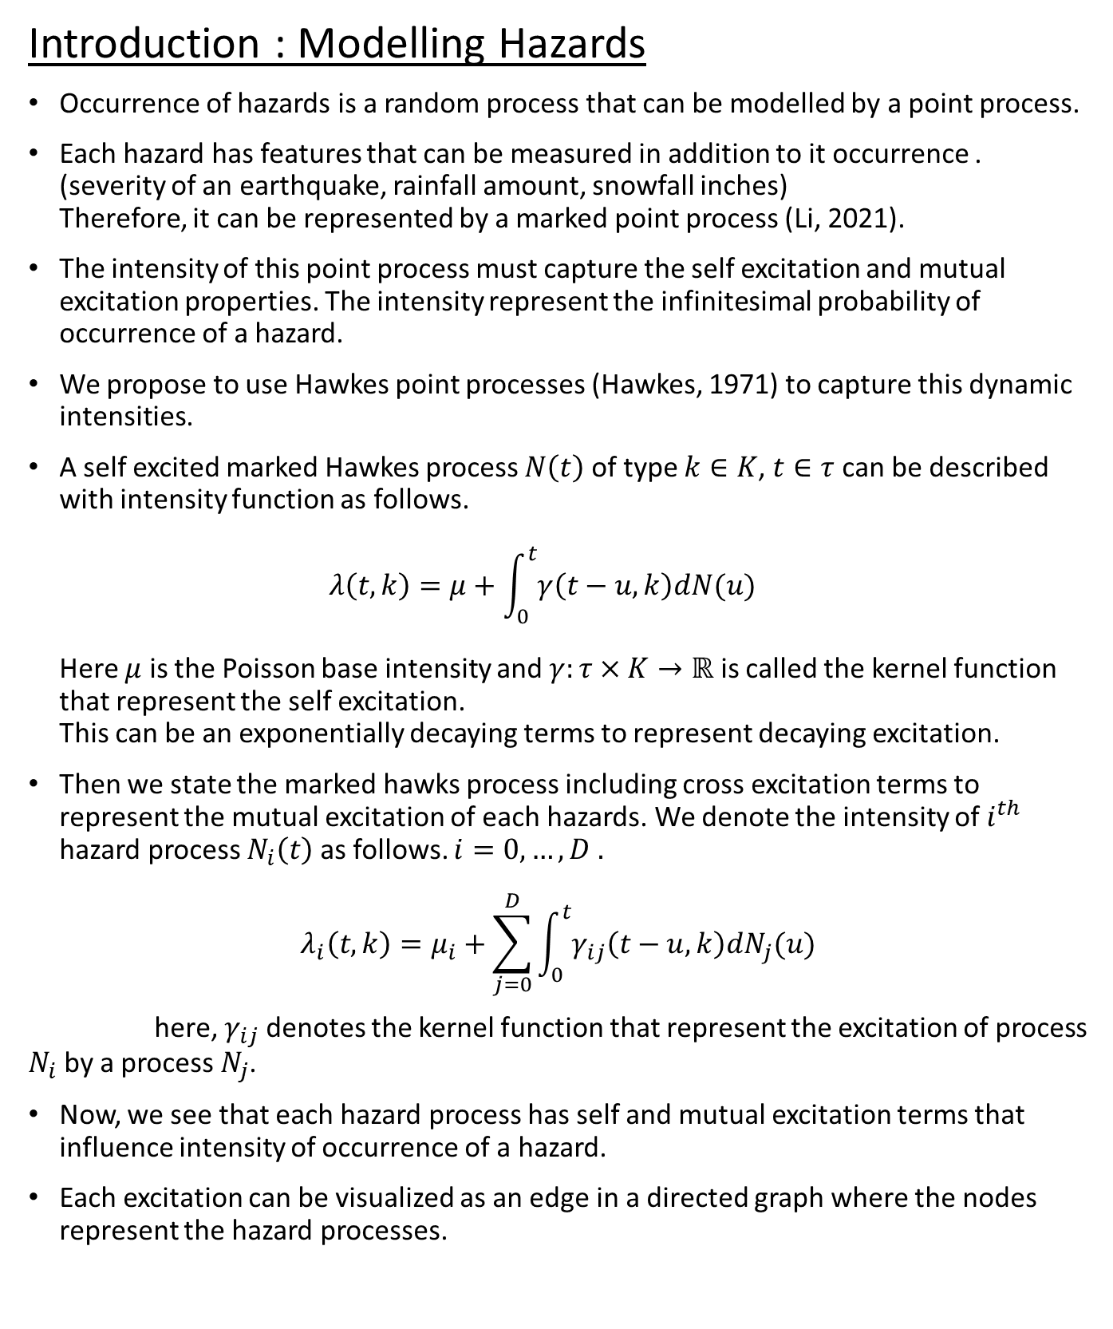
Introduction : Modelling Hazards
Occurrence of hazards is a random process that can be modelled by a point process.
Each hazard has features that can be measured in addition to it occurrence . (severity of an earthquake, rainfall amount, snowfall inches) Therefore, it can be represented by a marked point process (Li, 2021).
The intensity of this point process must capture the self excitation and mutual excitation properties. The intensity represent the infinitesimal probability of occurrence of a hazard.
We propose to use Hawkes point processes (Hawkes, 1971) to capture this dynamic intensities.
A self excited marked Hawkes process $N\left(t\right)$ of type $k∈K$, $t∈τ$ can be described with intensity function as follows. $λ\left(t,k\right)=μ+\int_{0}^{t}{γ\left(t−u,k\right)dN(u)}$ Here $μ$ is the Poisson base intensity and $γ:τ×K→ℝ$ is called the kernel function that represent the self excitation. This can be an exponentially decaying terms to represent decaying excitation.
Then we state the marked hawks process including cross excitation terms to represent the mutual excitation of each hazards. We denote the intensity of $i^{th}$ hazard process $N_{i}\left(t\right)$ as follows. $i=0,…,D .$
$$λ_{i}\left(t,k\right)=μ_{i}+\sum_{j=0}^{D}{\int_{0}^{t}{γ_{ij}\left(t−u,k\right)dN_{j}(u)}}$$ here, $γ_{ij}$ denotes the kernel function that represent the excitation of process $N_{i}$ by a process $N_{j}$.
Now, we see that each hazard process has self and mutual excitation terms that influence intensity of occurrence of a hazard.
Each excitation can be visualized as an edge in a directed graph where the nodes represent the hazard processes.

Slide 4
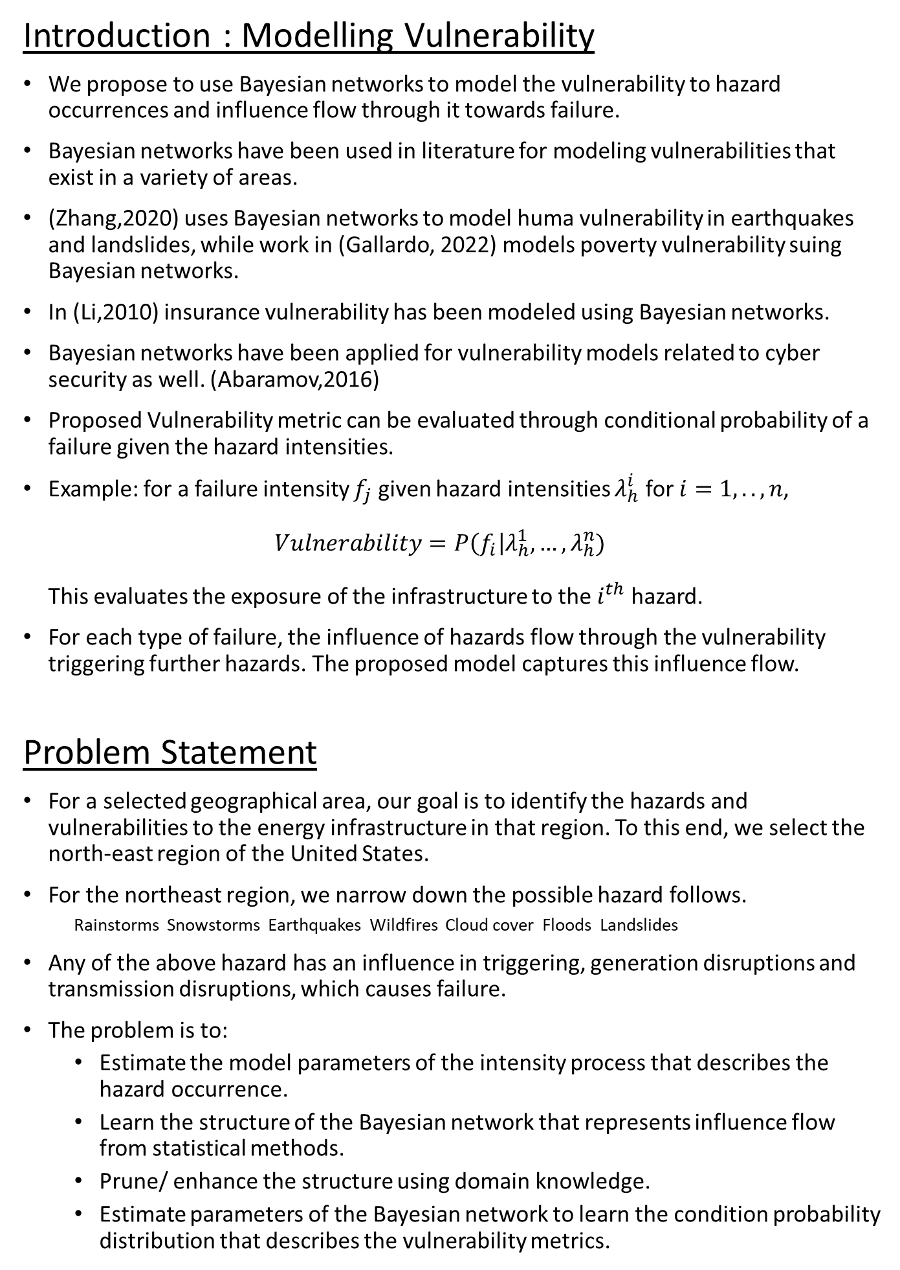
Introduction : Modelling Vulnerability
We propose to use Bayesian networks to model the vulnerability to hazard occurrences and influence flow through it towards failure.
Bayesian networks have been used in literature for modeling vulnerabilities that exist in a variety of areas.
(Zhang,2020) uses Bayesian networks to model huma vulnerability in earthquakes and landslides, while work in (Gallardo, 2022) models poverty vulnerability suing Bayesian networks.
In (Li,2010) insurance vulnerability has been modeled using Bayesian networks.
Bayesian networks have been applied for vulnerability models related to cyber security as well. (Abaramov,2016)
Proposed Vulnerability metric can be evaluated through conditional probability of a failure given the hazard intensities.
Example: for a failure intensity $f_{j}$ given hazard intensities $λ_{h}^{i}$ for $i=1,..,n$, $Vulnerability=P\left(f_{i}\right|λ_{h}^{1},…,λ_{h}^{n})$ This evaluates the exposure of the infrastructure to the $i^{th}$ hazard.
For each type of failure, the influence of hazards flow through the vulnerability triggering further hazards. The proposed model captures this influence flow.
Problem Statement
For a selected geographical area, our goal is to identify the hazards and vulnerabilities to the energy infrastructure in that region. To this end, we select the north-east region of the United States.
For the northeast region, we narrow down the possible hazard follows.
Rainstorms Snowstorms Earthquakes Wildfires Cloud cover Floods Landslides
Any of the above hazard has an influence in triggering, generation disruptions and transmission disruptions, which causes failure.
The problem is to:
Estimate the model parameters of the intensity process that describes the hazard occurrence.
Learn the structure of the Bayesian network that represents influence flow from statistical methods.
Prune/ enhance the structure using domain knowledge.
Estimate parameters of the Bayesian network to learn the condition probability distribution that describes the vulnerability metrics.

Slide 5
Estimating the hazard model
Learning the hazard model, involves modeling the hazards and their cross excitations by a set of Hawkes intensity processes.
It requires data on recorded hazard occurrences for estimating the hawkes process kernels and their cross-excitation coefficients.
Estimating the Vulnerability model
We start with statically learning the structure of the vulnerability network.
However, statistical structure learning methods usually yield highly complex structures, (Song,2012)
Therefore, we employ domain knowledge to do pruning and adjustments to the network.
An example vulnerability network for northeast would be as follows.
With the network structure fixed, we can then learn the parameters of the conditional probability distributions to do inference using the graph.
Severe weather – Rainstorms
Earthquakes
Severe weather – Snowstorms
Wildfires
Cloud cover
Floods
landslides
Generation Disruption
Transmission/ Distribution line disruption

Slide 6
Required Data
Precipitation Data- Rainstorms-Snowstorms – NASA POWER
Cloud- Cover – NASA POWER
Earthquake Data -
Wildfire Data
Floods
Landslides
Energy Infrastructure data- Homeland Infrastructure Foundation-Level Data (HIFLD)
Generation types- locations
Critical Transmission arterials- graph
Historical record of disruptions
Baselines
Parametric regression models
Decision trees

Slide 7
References
Li, X., Genest, C., & Jalbert, J. (2021). A self-exciting marked point process model for drought analysis. Environmetrics, 32(8), e2697. https://doi.org/10.1002/env.2697
Alan G. Hawkes, Spectra of some self-exciting and mutually exciting point processes, Biometrika, Volume 58, Issue 1, April 1971, Pages 83–90, https://doi.org/10.1093/biomet/58.1.83
Embrechts, P., Kirchner, M. (2018). Hawkes graphs. Theory of Probability & Its Applications, 62(1), 132–156. https://doi.org/10.1137/s0040585x97t988538
Song, Wenting, et al. "Bayesian network structure learning from attribute uncertain data." Web-Age Information Management: 13th International Conference, WAIM 2012, Harbin, China, August 18-20, 2012. Proceedings 13. Springer Berlin Heidelberg, 2012.

